Slide 1
Process Activities

Slide 2
Requirement Gathering

Slide 3
WHY REQUIREMENTS GATHERING & ANALYSIS?
“Measure twice, cut once”
“Look before you leap”
What do these sayings have in common? They're about Thinking before Acting.
Why?
Because it Saves time, money and effort.

Slide 4
WHAT IS REQUIREMENTS GATHERING?
A Process of Collecting the user needs to Solve a problem or issues and Achieve an objective.
An important Phase in a project life cycle If the Requirements Gathering is not done properly, All below phases get incomplete.
No matter how good the Design is Requirements are the foundation of any Project If you don’t know where you’re going, any road will take you there!

Slide 5
WHAT IS A REQUIREMENT?
A requirement is a capability that a product must possess to satisfy a customer need or objective.
They help a project team define,
Goals
Scope of the work
They provide objective ways to measure the project's success

Slide 6
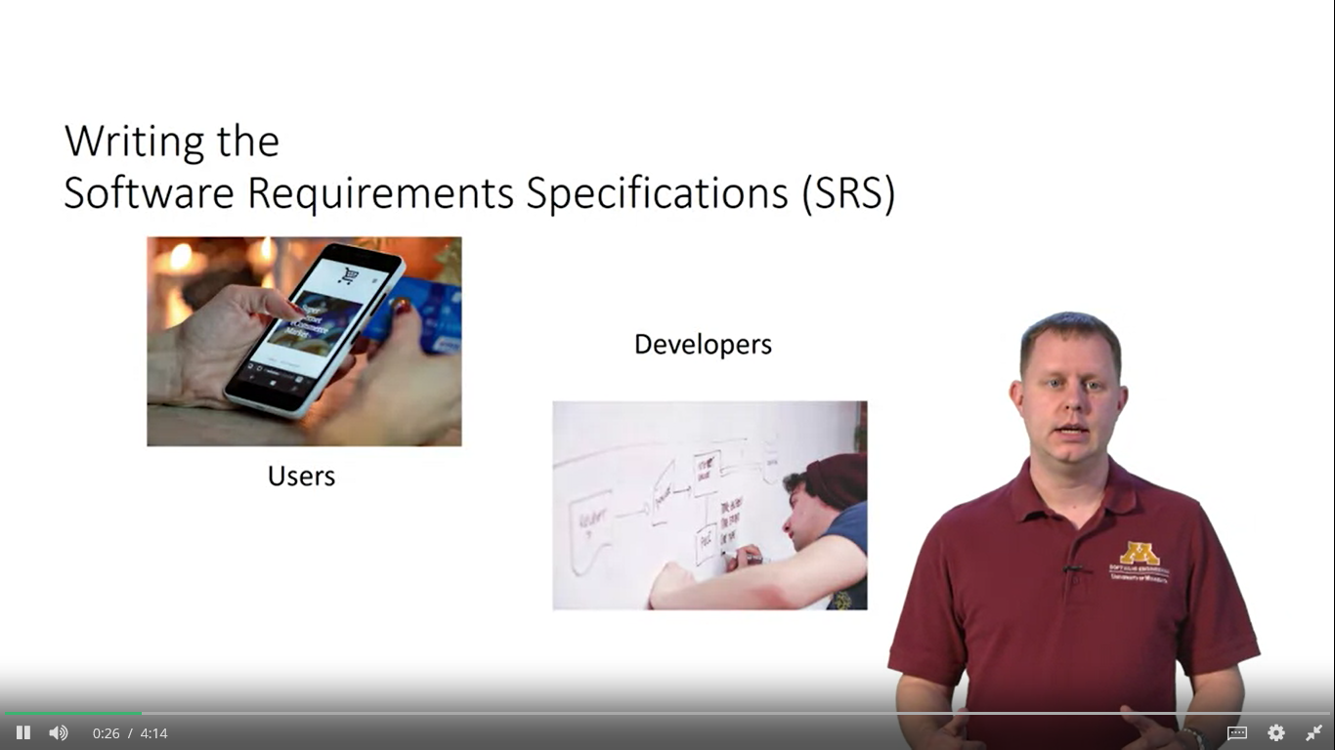
Requirement vs Specification

Slide 7
Requirement vs Specification
Requirements are user needs
System spec is the usually more precise or constraining statement of how the system will meet the user requirements.

Slide 8
Example
User requirements
System must be secured.
System Specification.
User must be registered in system before accessing the system.
Login should be provided.
User can’t access data of other users account.
Etc.

Slide 9
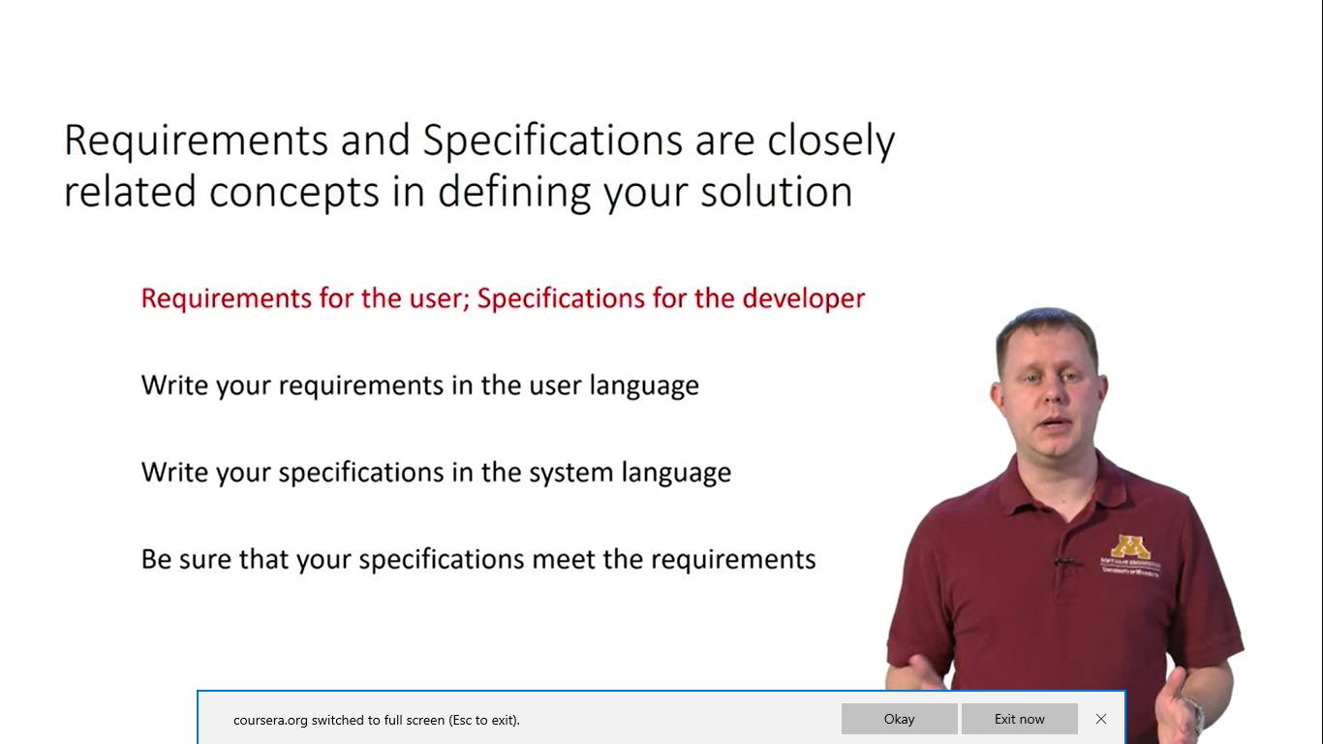
Recommendations

Slide 10
System Requirements
Whitney High School in Cerritos California wants to design a Student Management System on Initial level we have two users student and a teacher. The system represent the specific functionality of a student management system. A student can perform only these interactions with the system he can check attendance, timetable as well as test marks on the application or a system. A teacher can interact with all the functionalities of the system. Teacher can also update the attendance of a student and marks of the student. These interactions of both student and a teacher actor together sums up the entire student management application.

Slide 11
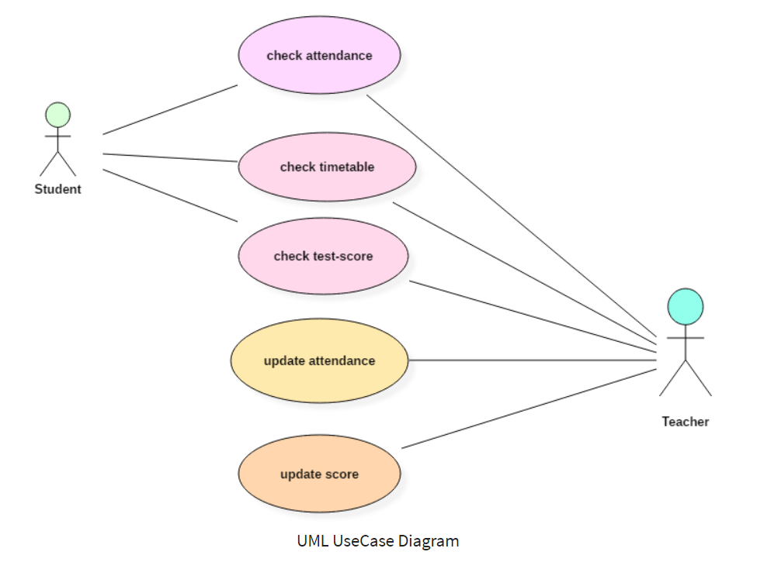
System Specifications

Slide 12
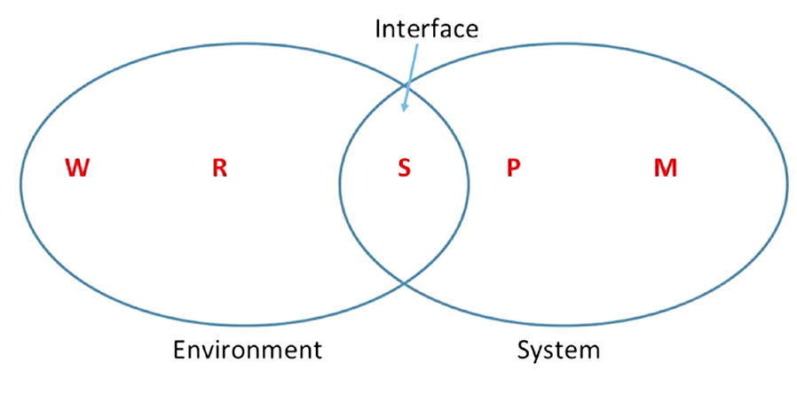
WRSPM Reference model or The World Machine Model
Capturing the right thing.

Slide 13
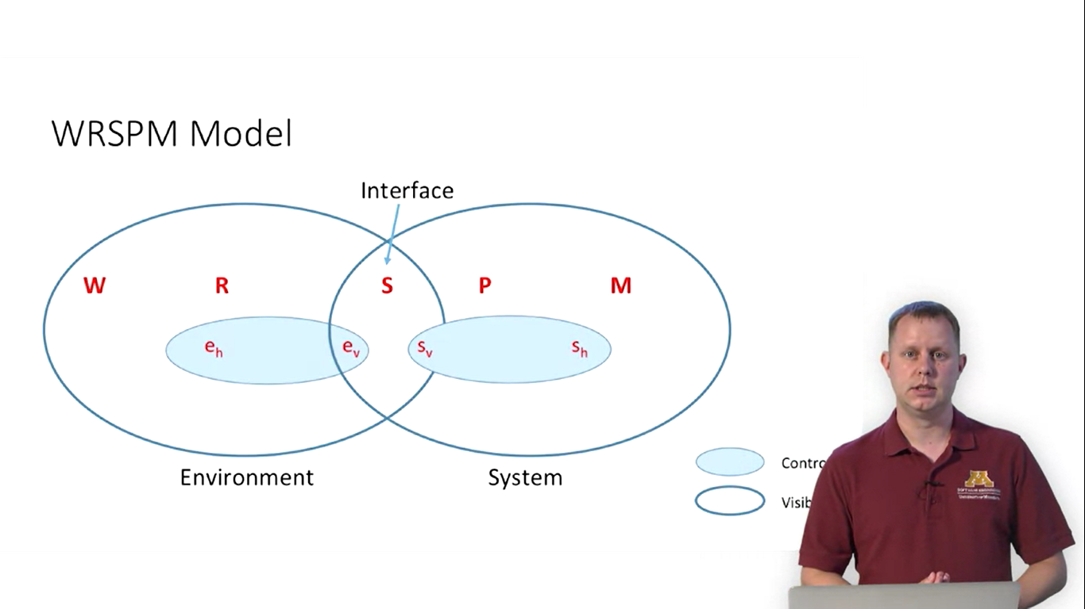

Slide 14
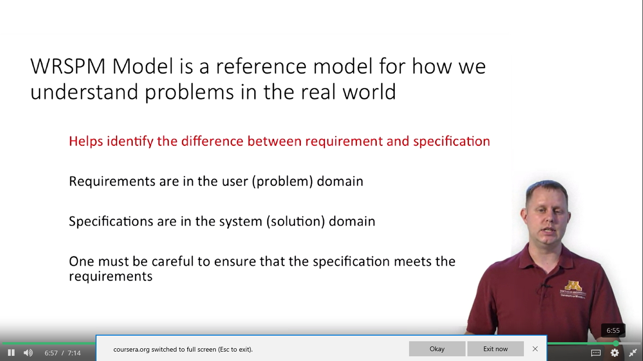
WRSPM Model

Slide 15
Design

Slide 16
Introduction
Software design is a process to transform user requirements into some suitable form, which helps the programmer in software coding and implementation.
For assessing user requirements, an SRS (Software Requirement Specification) document is created whereas for coding and implementation, there is a need of more specific and detailed requirements in software terms.
The output of this process can directly be used into implementation in programming languages.

Slide 17
Modularization
Modularization is a technique to divide a software system into multiple discrete and independent modules, which are expected to be capable of carrying out task(s) independently.
These modules may work as basic constructs for the entire software. Designers tend to design modules such that they can be executed and/or compiled separately and independently.
Modular design unintentionally follows the rules of ‘divide and conquer’ problem-solving strategy this is because there are many other benefits attached with the modular design of a software.

Slide 18
Principles of Modularity
Complex problem must be broken down in small parts.
Three primary goals,
Decomposability
Composability
Ease of understanding

Slide 19
Aspects of Modularity
Coupling
Cohesion
Information Hiding and Data Encapsulation

Slide 20
Coupling
Coupling is a measure that defines the level of inter-dependability among modules of a program.
The lower the coupling, the better the program.

Slide 21
Tight Coupling
Content Coupling : Suppose module A directly rely on local data members of module B.
Common Coupling: Suppose module A and B both rely on some global data or variable.
External Coupling: Suppose A and B both rely on some protocol or standard.

Slide 22
Medium Coupling
Control Coupling: Suppose module A decides the function of the other module B or changes its logical flow of execution.
Data Structure Coupling : Suppose module A and B rely on same composite data structure and change of data structure in one module affect other module.

Slide 23
Loose Coupling
Data Coupling: Only parameters are shared between 2 modules.
Message Coupling: No centralize communication between modules. Only message passing can be possible between modules.
No Coupling: No interaction among modules.

Slide 24
Cohesion
Cohesion is a measure that defines the degree of intra-dependability within elements of a module.
The greater the cohesion, the better is the program design.
Implements a single logical entity or function.

Slide 25
Weak Cohesion
Co-incidental cohesion: It is unplanned and random cohesion, which might be the result of breaking the program into smaller modules for the sake of modularization.
Temporal Cohesion: When elements of module are organized such that they are processed at a similar point in time, it is called temporal cohesion.
Procedural cohesion - When elements of module are grouped together, which are executed sequentially in order to perform a task, it is called procedural cohesion.
Logical cohesion - When logically categorized elements are put together into a module, it is called logical cohesion.

Slide 26
Medium Cohesion
Communicational cohesion - When elements of module are grouped together, which are executed sequentially and work on same data (information), it is called communicational cohesion.
Sequential cohesion - When elements of module are grouped because the output of one element serves as input to another and so on, it is called sequential cohesion.

Slide 27
Strong Cohesion
Functional Cohesion: It is considered to be the highest degree of cohesion, and it is highly expected. Elements of module in functional cohesion are grouped because they all contribute to a single well-defined function. It can also be reused.

Slide 28
Information Hiding
Hide the complexity in “black box”.
How to use system is your concern not how the system provide this functionality.
E.g.: If you want a system which can sort an array, You are not concerned the type of sorting algorithm used in the system.

